Slide 1

SIMCOM MODULE FEATURES
WangYong
Feb 25, 2006

Slide 2

Agenda
Roadmap
SIM300 features
Other modules features
Discussion

Slide 3
Roadmap
UMTS(HSDPA)/GPRS/EDGE Module
SIM800
TD-SCDMA/GSM/GPRS Module
850/900/1800/1900
B2B Connector
Edge Module
SIM600
TD800
(850)900/1800/1900
GSM/GPRS SMT Module for Handhold
SIM300D
(850)900/1800/1900
B2B connector
GSM/GPRS+GPS Module
SIM508
(850)900/1800/1900
B2B Connector
GSM/GPRS for Handhold
(850)900/1800/1900
DIP connector
GSM/GPRS for M2M
SIM300C
SIM300A3
SIM306
(850)900/1800/1900
GSM/GPRS MMS Module
(850)900/1800/1900
B2B Connector
GSM/GPRS for WLL
SIM300
Q3 2005
Q4 2005
Q1 2006
Q2 2006
Q3 2006
Q4 2006
MP
Developing

Slide 4
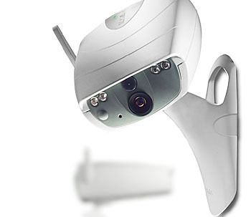
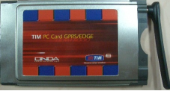
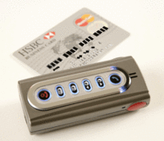
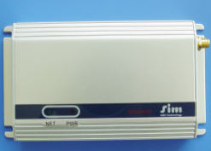
Roadmap
UMTS/HSDPA/GPRS/EDGE
Modem
UMTS/HSDPA/GPRS/EDGE
PC Card
SIM-T06
Modem
850/900/1800/1900
Edge Class 12
GPRS Class 10
Edge PCMCIA Card
850/900/1800/1900
Edge Class 12
GPRS Class 10
Observation Cameral Terminal
GSM+GPS Terminal
SIM-T01
Modem
900(850)/1800/1900MHz
GPRS Class 10
Q2 2005
Q3 2005
Q4 2005
Q1 2006
Q2 2006
Q3 2006
Q4 2006
MP
Developing
Planning

Slide 5
SIM300
1:Tri-band(900/1800/1900) GPRS Class 10
2: 40x33x2.85mm 60-pin ENTERY board to board connector
3: Sleep mode(about 2.5mA)
4: Embeded TCP/IP with transparent mode
5: Autobauding
6: Over-temperature automatic shutdown
7: SIM card detection function
8: All software version based on V10.0

Slide 6
Defferrents between
SIM300 and SIM100S
1.Power on mode
2.Buzzer pin
3.Add SIM_PRESENCE pin
4.Audio circuit
5.The level of Vext

Slide 7
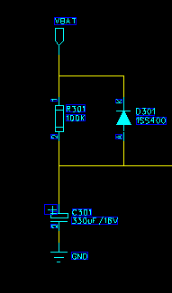
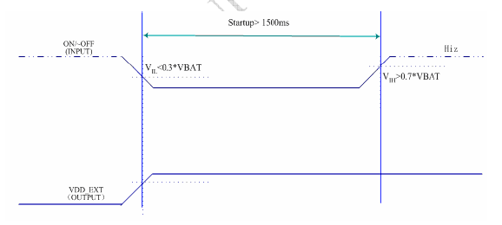
SIM300 Hardware Features
Turn on SIM300 using the PWRKEY pin

Slide 8
SIM300 Hardware Features
The PIN36 of SIM300 is the BUZZER, but the PIN36 of SIM100S is the RESET .
The PIN32 of SIM300 is GPIO5, but the PIN32 of SIM100S is the BUZZER.
The SIM300 don’t provide the reset pin.

Slide 9
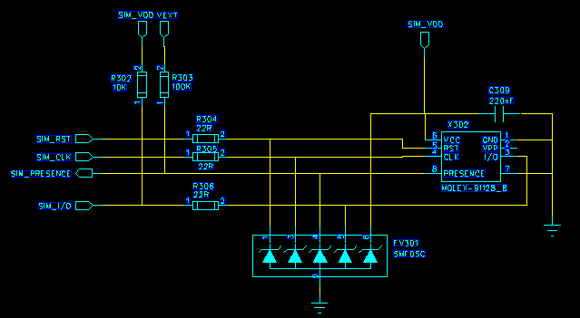
SIM300 Hardware Features
The SIM_PRESENCE pin (PIN16) is used for detecting the SIM card removal.

Slide 10
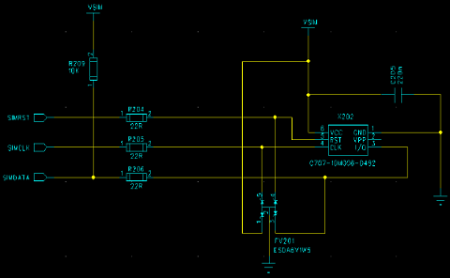
SIM300 Hardware Features
If you don’t use the SIM card detection function, you can let the SIM_PRESENCE pin NC or connect to GND.

Slide 11
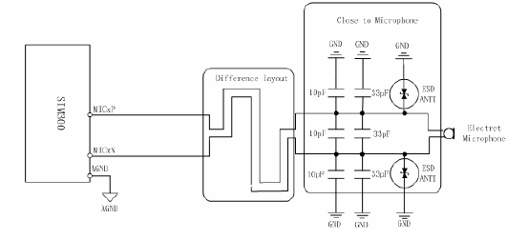
SIM300 Hardware Features
When customer use SIM300 audio function, don’t need use MIC bias. It may reduce the customer’s BOM.The speaker’s circuit is same as SIM100S.

Slide 12
SIM300 Hardware Features
The Vext level of SIM300 is the 3.0V/60mA.
The Vext level of SIM100S is the 2.8V/10mA.
The customer may use Vext to dirve the other IC, for example LCD and serial port IC.

Slide 13
Other modules features

Slide 14
SIM340 Features
The SIM340 is same as SIM300 except working frequence.
SIM300 is Tri-band module ,SIM340 is Quad-band module

Slide 15
SIM300A3/A4 Features
SIM300A3 is Tri-band module:
GSM900,DCS1800,PCS1900.
SIM300A4 is Quad-band module:
GSM850,GSM900,DCS1800,PCS1900
Their every pin function is same as SIM200,the type of connector is MOLEX-52974-0608.

Slide 16
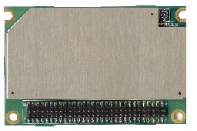
SIM300C Features
Tri-band or Quad-band(SIM340C) GSM/GPRS module
The module size is 50x33x6.2mm
DIP type board to board connector suite for vehicle application

Slide 17
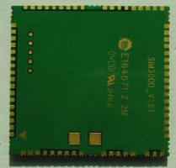
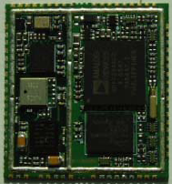
SIM300D Features
SIM300D is the complete Tri-band /Quad-band (SIM340D) GSM/GPRS solution in SMT module which can be embedded in customer applications.

Slide 18
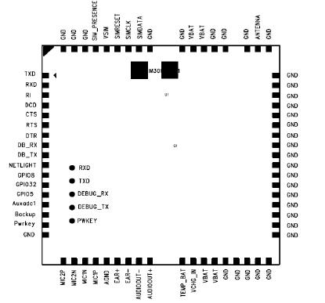
SIM300D Features

Slide 19
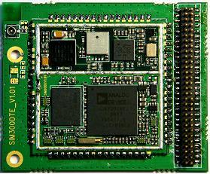
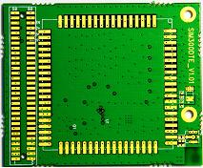
SIM300D Features
Size :33x33x3 mm
Weight: 7g

Slide 20
SIM306 Features
Embedded powerful MMS protocol stack.
MMS context setting via AT command .
MMS send control via AT command.
Easy send picture file data to SIM306 by Data Transparent mode .
The MMS target address can be mobile phone number and email.

Slide 21
SIM306 Features
Security camera system
CAMERA
SENSOR
DSP
MCU
Serial port
SIM306
SMS
MMS
MMS
Mobile network
SMS gateway
Mobile network
MMS gateway
Mobile network
gateway
SMS
MMS
EMAIL
Mobile phone 1
Mobile phone 2
Etc….
WWW EMAIL
ADDRESS
MMS mobile phone

Slide 22
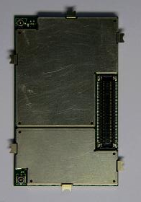
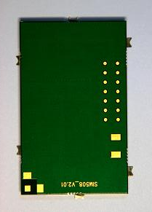
SIM508 Features
GSM/GPRS & GPS module

Slide 23
Thank you!

